Slide 1


Chapter 9
Benefit/Cost Analysis
Lecture slides to accompany
Engineering Economy
8th edition
Leland Blank
Anthony Tarquin
9-<number>

Slide 2
LEARNING OUTCOMES
Explain difference in public vs. private sector projects
Calculate B/C ratio for single project
Select better of two alternatives using B/C method
Select best of multiple alternatives using B/C method
Use cost-effectiveness analysis (CEA) to evaluate service sector projects
6. Describe how ethical compromises may enter public
sector projects
9-<number>

Slide 3
Differences: Public vs. Private Projects
Characteristic Public Private
Size of Investment Large Small, medium, large
Life Longer (30 – 50+ years) Shorter (2 – 25 years)
Annual CF No profit Profit-driven
Funding Taxes, fees, bonds, etc. Stocks, bonds, loans, etc.
Interest rate Lower Higher
Selection criteria Multiple criteria Primarily ROR
Environment of evaluation Politically inclined Economic
9-<number>

Slide 4
Types of Contracts
Contractors does not share project risk
Fixed price - lump-sum payment
Cost reimbursable - Cost plus, as negotiated
Contractor shares in project risk
Public-private partnerships (PPP), such as:
  Design-build projects - Contractor responsible from design stage to operations stage
  Design-build-operate-maintain-finance (DBOMF) projects - Turnkey project with contractor managing financing (manage cash flow); government obtains funding for project
  BTO(Build-Transfer-Operate): does not guarantee proper profit by the government →수익형민자사업
  BTL(Build-Transfer-Lease ): guarantee proper profit by the government → 임대형민자사업
9-<number>

Slide 5

Cash Flow Classifications and B/C Relations
Must identify each cash flow as either benefit, ________, or cost
Benefit (B) -- Advantages to the public
Disbenefit (D) -- Disadvantages to the public
Cost (C) -- Expenditures by the government
Preferred
Conventional B/C ratio = (B–D) / C
Modified B/C ratio = [(B–D) – C] / Initial Investment
Profitability Index = NCF_{i≠0} / Initial Investment
Note 1: All terms must be expressed in same units, i.e., PW, AW, or FW
Note 2: Do not use _____ sign ahead of costs
9-<number>

Slide 6
Decision Guidelines for B/C and PI
Benefit/cost analysis
If B/C ≥ 1.0, project is economically justified at discount rate applied
If B/C < 1.0, project is ___ economically acceptable
Profitability index analysis of
revenue projects
If PI ≥ 1.0, project is economically justified at discount rate applied
If PI < 1.0, project is ___ economically acceptable
9-<number>

Slide 7
B/C Analysis – Single Project
B - D
Conventional B/C ratio =
C
If B/C ≥ 1.0,
accept project;
otherwise, reject
B – D – M&O
_________ B/C ratio =
C
PW of NCF_{t≠0}
Denominator is
____ investment
PI =
PW of initial investment
If PI ≥ 1.0,
accept project;
otherwise, reject
9-<number>

Slide 8
B/C Analysis – Single Project
B | OR | B - M | ?
I + M |  | I
 | Annual value |  |  |  | IRR | B |  | B - M
 | I | B | M | PV |  | I + M |  | I
a | 8,024 | 23,856 | 7,880 | 7,952 | 15% | 1.50 |  | 1.99
b | 8,024 | 16,500 | 524 | 7,952 | 15% | 1.93 |  | 1.99
c | 8,024 | 17,500 | 1,524 | 7,952 | 15% | 1.83 |  | 1.99
d | 8,024 | 18,500 | 2,524 | 7,952 | 15% | 1.75 |  | 1.99
9-<number>

Slide 9
Example: B/C Analysis – Single Project
A flood control project will have a first cost of $1.4 million with an annual
maintenance cost of $40,000 and a 10 year life. Reduced flood damage is
expected to amount to $175,000 per year. Lost income to farmers is estimated
to be $25,000 per year. At an interest rate of 6% per year, should the
project be undertaken?
Solution: Express all values in ____ terms and find ___________ B/C ratio
B = $175,000
D = $25,000
C = 1,400,000(A/P,6%,10) + $40,000 = $230,218
B/C = (175,000 – 25,000)/230,218
= 0.65 < 1.0
Do not build project
9-<number>

Slide 10
Defender, Challenger and Do Nothing Alternatives
When selecting from two or more ME alternatives, there is a:
Defender – in-place system or currently selected alternative
Challenger – Alternative challenging the defender
Do-nothing option – Status quo system
General approach for incremental B/C analysis of two ME alternatives:
Lower total cost alternative is first compared to ___________ (DN)
If B/C for the lower cost alternative is < 1.0, the DN option is compared to
B/C of the higher-cost alternative
If both alternatives lose out to DN option, DN prevails, unless overriding
needs requires selection of one of the alternatives
9-<number>

Slide 11
Alternative Selection Using Incremental B/C Analysis – Two or More ME Alternatives
Procedure similar to ____ analysis for multiple alternatives
Determine equivalent total cost for each alternative
Order alternatives by __________ total cost
Identify B and D for each alternative
Calculate B/C for each alternative and eliminate all with B/C < 1.0
Determine ___________ costs and benefits for first two alternatives
Calculate ∆B/C; if >1.0, ______ cost alternative becomes defender
Repeat steps 5 and 6 until only one alternative remains
9-<number>

Slide 12
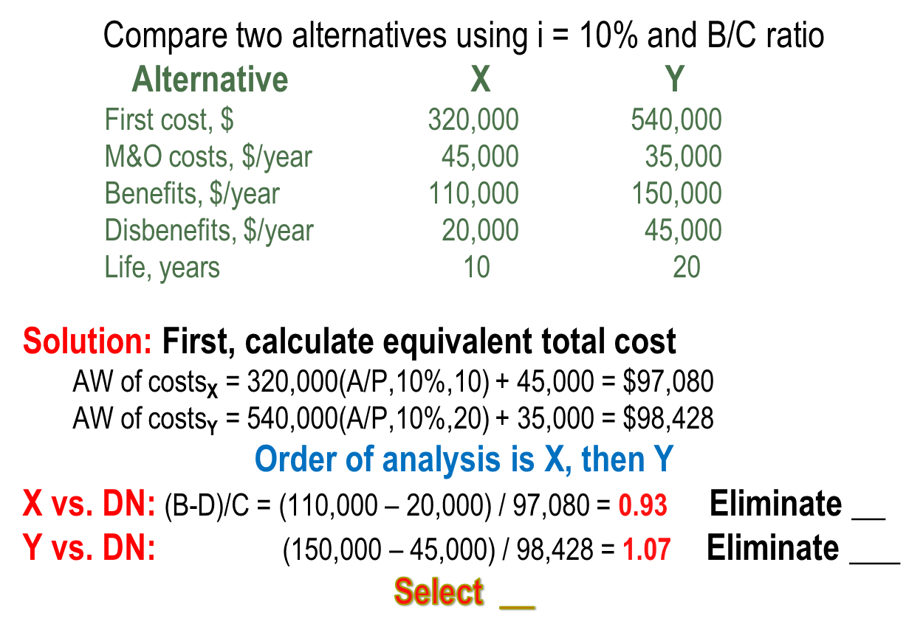
Example: Incremental B/C Analysis
9-<number>

Slide 13
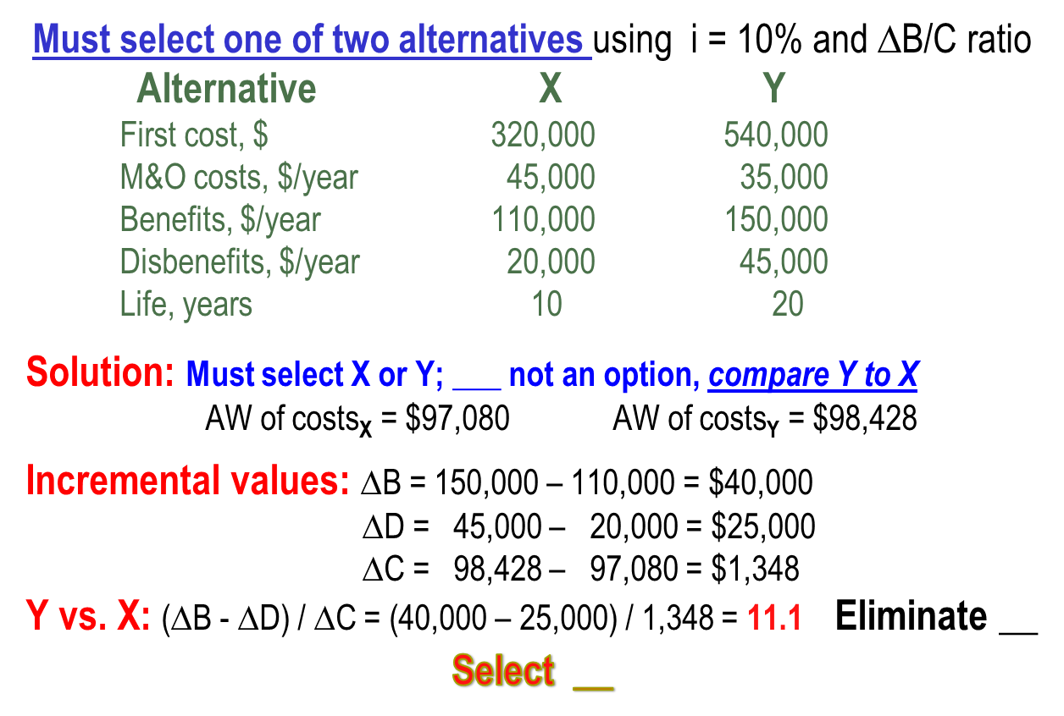
Example: ∆B/C Analysis; Selection Required
9-<number>

Slide 14
B/C Analysis of Independent Projects
Independent projects comparison does not require ___________ analysis
Compare each alternative’s overall B/C with DN option
No budget limit: Accept ___ alternatives with B/C ≥ 1.0
Budget limit specified: capital budgeting problem; selection follows different procedure (________ Problem)
9-<number>

Slide 15

Cost Effectiveness Analysis
Service sector projects primarily involve ____________, not physical facilities; examples include health care, security programs, credit card services, etc.
Cost-effectiveness analysis (CEA) combines monetary cost
estimates with non-________ benefit estimates to calculate the
Cost-effectiveness ratio (CER)
Equivalent total costs
Total effectiveness measure
= C/E
CER =
9-<number>

Slide 16
CER Analysis for Independent Projects
Procedure is as follows:
(1) Determine equivalent total cost C, total effectiveness measure E and CER
(2) Order projects by __________ to largest CER
(3) Determine cumulative cost of projects and compare to budget limit b
(4) Fund all projects such that b is not exceeded
Example: The effectiveness measure E is the number of graduates from adult training programs. For the CERs shown, determine which independent
programs should be selected; b = $500,000.
Program CER, $/graduate Program Cost, $
A 1203 305,000
B 752 98,000
C 2010 126,000
D 1830 365,000
9-<number>

Slide 17
Example: CER for Independent Projects
First, rank programs according to __________ CER:
Cumulative
Program CER, $/graduate Program Cost, $ Cost, $
B 752 98,000 98,000
A 1203 305,000 403,000
D 1830 365,000 768,000
C 2010 126,000 894,000
Next, select programs until budget is not exceeded
Select programs B and A at total cost of $403,000
Note: To expend the entire $500,000, accept as many additional individuals as possible from D at the per-student rate
9-<number>

Slide 18
CER Analysis for Mutually Exclusive Projects
Procedure is as follows
(1) Order alternatives smallest to largest by effectiveness measure E
Calculate CER for first alternative (defender) and compare to DN option
Calculate incremental cost (∆C), effectiveness (∆E), and incremental measure
∆C/E for challenger (next higher E measure)
If ∆C/E_{challenger} < C/E_{defender} challenger becomes defender (dominance);
otherwise, no dominance is present and both alternatives are retained
(5) Dominance present: Eliminate defender and compare next alternative
to new defender per steps (3) and (4).
Dominance not present: Current challenger becomes new defender against
next challenger, but old defender remains viable
(6) Continue steps (3) through (5) until only 1 alternative remains or only
non-dominated alternatives remain
(7) Apply budget limit or other criteria to determine which of remaining
non-dominated alternatives can be funded
9-<number>

Slide 19
Example: CER for ME Service Projects
The effectiveness measure E is wins per person. From the cost and effectiveness values shown, determine which alternative to select.
Cost (C) Effectiveness (E) CER
Program $/person wins/person $/win
A 2200 4 550
B 1400 2 700
C 6860 7 980
9-<number>

Slide 20
Example: CER for ME Service Projects
Solution:
Order programs according to increasing effectiveness measure E
Cost (C) Effectiveness (E) CER
Program $/person wins/person $/win
B 1,400 2 700
A 2,200 4 550
  C 6,860 7 980
B vs. DN: C/E_{B} = 1400/2 = 700
A vs. B: ∆C/E = (2200 – 1400)/(4 – 2) = 400 Dominance; eliminate B
C vs. A: ∆C/E = (6860 – 2200)/(7 – 4) = 1553 No dominance; retain C
Must use other criteria to select either A or C
9-<number>

Slide 21
Ethical Considerations
Engineers are routinely involved in two areas
where ethics may be compromised:
Public policy making – Development of strategy, e.g., water system management (supply/demand strategy; ground vs. surface sources)
Public planning - Development of projects, e.g., water operations (distribution, rates, sales to outlying areas)
Engineers must maintain integrity and impartiality and
always adhere to Code of Ethics
9-<number>

Slide 22
Summary of Important Points
B/C method used in public sector project evaluation
Can use PW, AW, or FW for incremental B/C analysis, but must
be consistent with units for B,C, and D estimates
For multiple mutually exclusive alternatives, compare two at a time
and eliminate alternatives until ____ ____ remains
For independent alternatives with no budget limit, compare each against
DN and select all alternatives that have B/C ___ 1.0
CEA analysis for service sector projects combines cost and
____________ measures
Ethical dilemmas are especially prevalent in public sector projects
9-<number>

Slide 23
HOMEWORK
Please solve every Examples in your textbook. You do not have to submit your works.
Please upload following “PROBLEMS” solution file on “Assignment” menu in e-Class.
  9.16
  9.26
  9.35
  9.44
4-<number>

